Slide 1
Pawp:
The Big Idea
Leave Behind
By: Erin, Starla, Niko, Brooke

Slide 2
Situational Analysis
The Market
Pawp
Our objective is for our consumers to be aware that Pawp not only focuses on insurance for pets but also provides accurate, efficient telemedicine support, eliminating time spent and cost of in-person visits. Pawp provides exclusive amenities in demand that are at the forefront of the market, and should capitalize on propositions.
The US pet insurance industry is expected to increase drastically due to demand, but is limited by stringent regulations and prices. The market itself is expanding from simple insurance to more amenities, where Pawp provides adept coverage.
Consumer Insight
Consumers love their pet but hate the experience of going to the vet, even for minor issues. With Pawp one can bring the vet to their living room.

Slide 3
SWOT Analysis
Strengths
Pawp has plans for up to 6 pets
Pawp takes away some pets’ anxiety about vets since they can be treated in the comfort of their own home (money.com)
Offers care 24/7, so if something happens during the night that would require a vet’s advice, they don’t have to be rushed to the ER
Weaknesses
The consumers are either unaware of Pawp or have trouble differentiating the company from other pet insurance companies.
Pawp is not being advertised to a variety of audiences and not being advertised enough generally
Opportunities
Insight on dog owners 22-65 and people that purchase pet insurance: “I am a workaholic.” (MRI Simmons). Pawp has the opportunity to emphasize its convenience factor.
The market presents little brand loyalty, as customers to pet insurance are fairly new. Pawp can install itself as the first household name.
Threats
Consumers are skeptical of a virtual pet insurance company and scared they won’t get as effective treatment as bringing their pet to a vet.
Health insurance is confusing to most people, (Mintel: Health Insurance US 2021)
.

Slide 4
Positioning Statement
Action Spur
Pawp is a convenient and essential tool for pet owners as many are finding themselves with less time to take their pets into the vet as they go back to work post-pandemic.
Pawp’s should use the “eliminate complexity” action spur in order to get consumers to understand their business and realize that it is the obvious choice for pet owners.

Slide 5
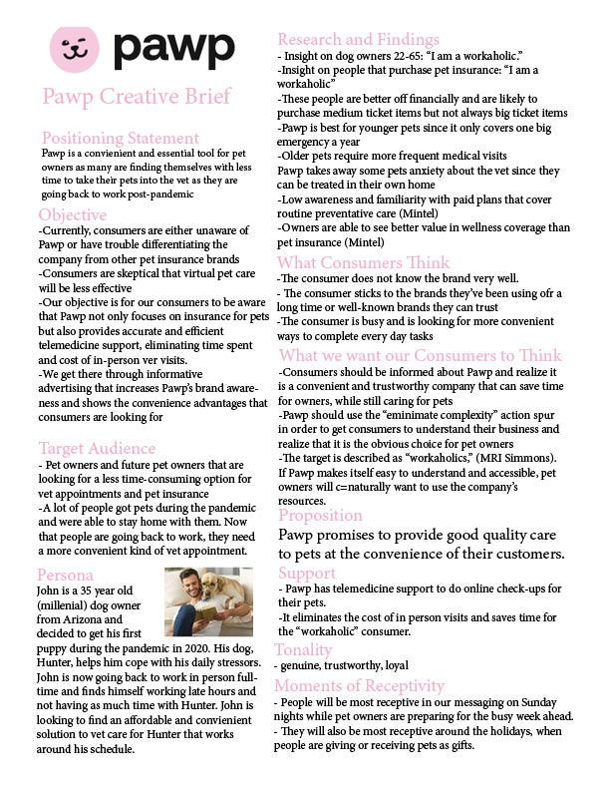
Creative Brief
and Persona

Slide 6
Media Recommendation
Video advertisement for social media (Tik Tok, Instagram), streaming services (Hulu, Amazon Prime, Paramount +, HBO Max)
Receptivity:
Media time mostly from 10am-4pm
84% of social media usage is done on smartphones
Over ¼ of streaming time is on services with ads (Nielsen)
Radio Advertisement for Spotify
Receptivity:
25% of Spotify users are 25-34 years old
Over 52% of the sample audience listens to music regularly throughout the day
Tonality: Warm, comforting, easy to understand.

Slide 7
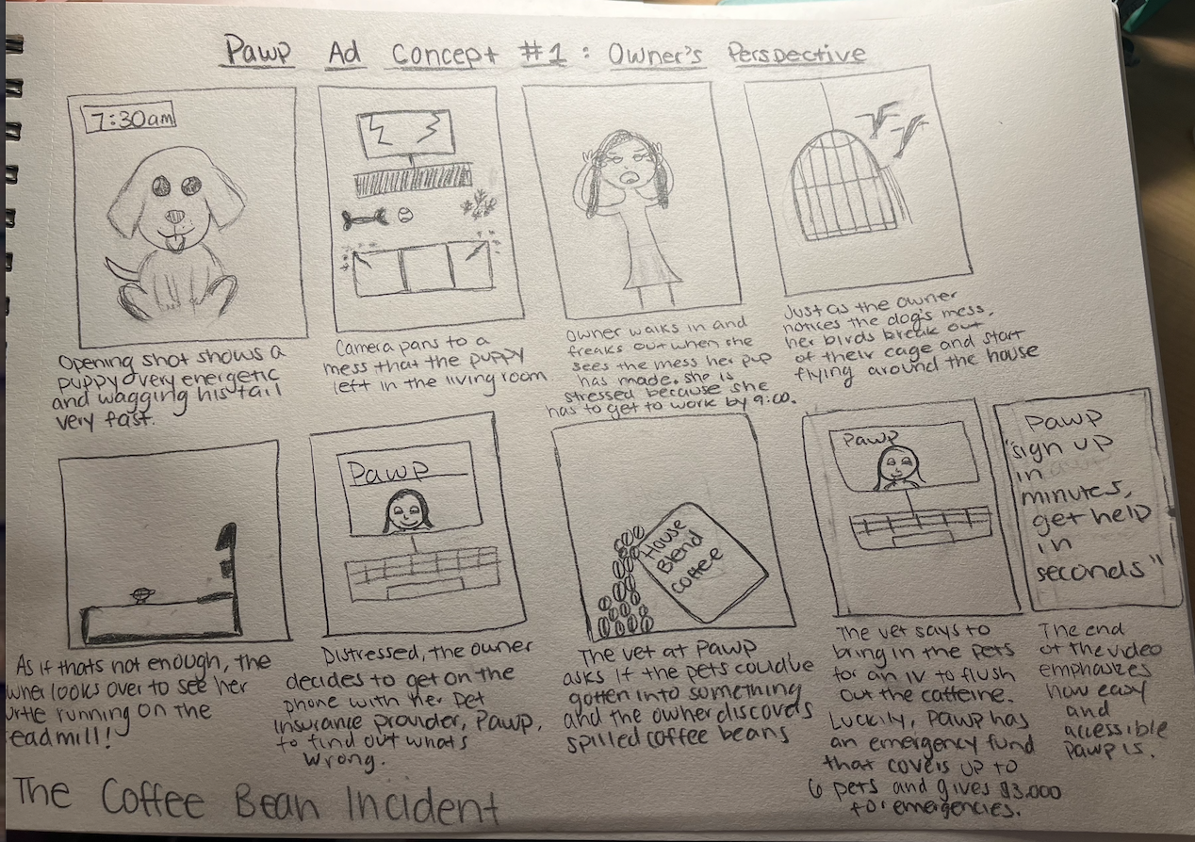
Ad Concept
A campaign that focuses on different types of minor pet health problems that can be easily resolved thanks to one of Pawp’s services, outlining the straightforwardness and accessibility of the product, can be used to resolve this problem.

Slide 8
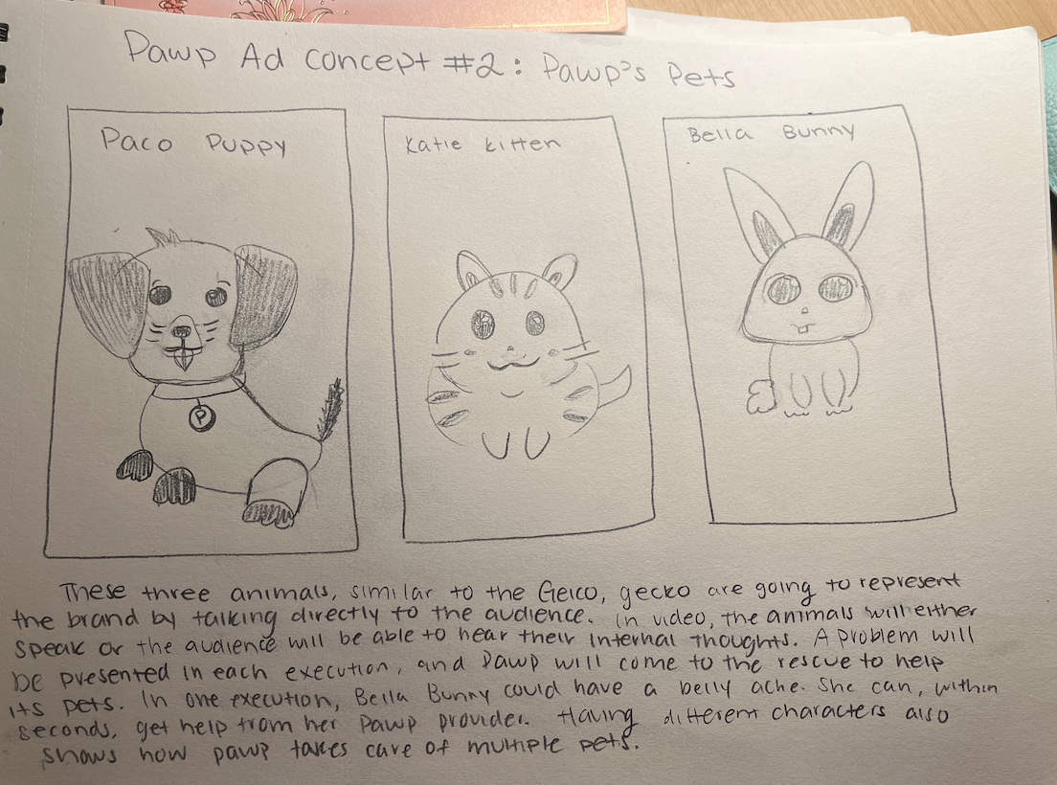
Ad Concept
Pawp’s Pets is an ad campaign that personifies Pawp’s clients. In this drawing we focus on three of Pawp’s pets. In each execution, the pet will go through a health issue, and Pawp will come to the rescue. This emphasizes how Pawp serves a variety of pets and can cover up to 6 in a plan. It again will reinforce how Pawp is accessible, helping with any issue at any time.

Slide 9
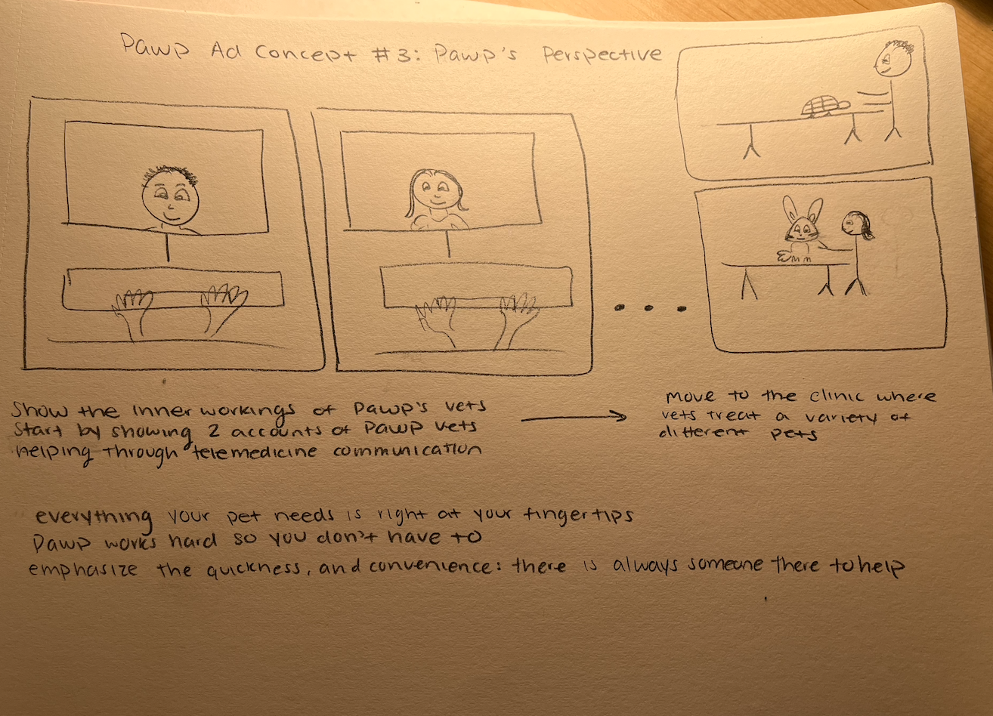
Ad Concept
This ad concept emphasizes the inner workings of Pawp as a company. It shows behind the scene of vets providing telemedicine support 24/7 as well as pets going in for check ups. This emphasizes how Pawp is always there for its customers at their convenience.

Slide 10
Ad Recommendation
Recommendation:
We recommend that Pawp go with Pawp’s Pets for their next campaign. This campaign will emphasize all of Pawp’s convenience aspects including how they cover multiple pets, how they provide telemedicine support 24/7, and how they provide emergency funds.
Social Media:
Each social media ad will highlight one of Pawp’s pets. In an Instagram or Tiktok post, the pet will inform the audience how Pawp has been a convenient resource to overcome health issues. The hashtag will be #PawpsPets
Radio:
Commercial:
In a television commercial, Pawp’s pets will be shown having an internal conflict. Whether that is they don’t feel well, or they are injured, Pawp will come to their rescue as the owner’s reach out for help. Emphasis will be placed on Pawp’s convenience factor.
Guided meditation led by Pawp’s pets.
Pawp’s pets are giving a guided meditation, while their friends continue to interrupt in the background. Not knowing what is wrong, the pets call up Pawp to help their friends calm down.

Slide 11
Going Viral
Social Currency:
Consumers can avoid the uncomfortable feeling of going to the vet with Pawp by providing direct online healthcare.
Triggers:
Seeing the Pawp mascots, noises of animals
Emotions:
Confidence, peace of mind, relief. Pawp aims to eliminate panic, stress and the complexity surrounding one’s pets’ health.
Public:
Instilling the idea that not all vet visits are inherently bad and that one should care for their pet as they do for themselves (cliché?)
Practical Value:
Multiple plans for multiple pets, eliminating the uneasy trip to the vet.
Stories:
Pawp pet mascot series, what people think of when they hear Pawp

Slide 12
RESOURCES
Mintel. (2021). Academic.mintel.com.libezproxy2.syr.edu. Mintel. Retrieved May 1, 2022, from http://academic.mintel.com.libezproxy2.syr.edu/display/860447/
Mintel. (2022, January 27). US Health Insurance Market Report 2021. Mintel Reports. Retrieved May 1, 2022, from https://reports.mintel.com/display/1045107/
MRI Simmons. (n.d.). Simmons Insights. MRI. Retrieved March 27, 2022, from https://insights.mrisimmons.com/catalyst/brandcatalyst
MRI Simmons. (n.d.). Simmons Insights. MRI. Retrieved March 27, 2022, from https://insights.mrisimmons.com/essentials/quickreports
Pawp. (n.d.). Ask a vet anything 24/7 & get $3,000 when you need it most. Pawp. Retrieved March 27, 2022, from https://pawp.com/
Tedder, M., & Reynolds, P. (2021, July 6). Pet telehealth is here. now your dog can zoom with the vet. Money. Retrieved March 27, 2022, from https://money.com/pawp-pet-telehealth/

